Slide 1
Hi!
Please make a name tent.

Slide 2
Working with Multilingual Writers
English 403
10/12/17

Slide 3
Thinking and writing…
What questions do you have about working with multilingual writers?

Slide 4
Agenda
1. Introduction and Framing
2. Student Experiences
3. Group Discussions
4. Debrief

Slide 5
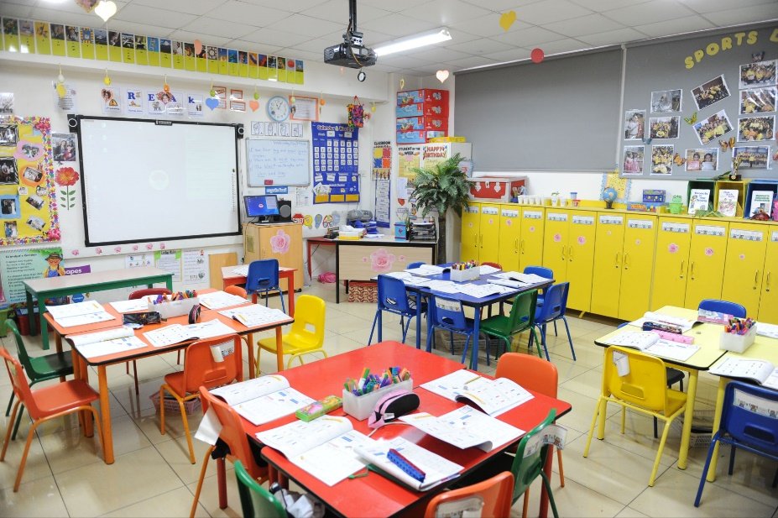

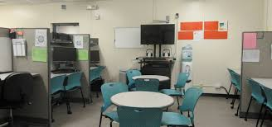
How I come to this work

Slide 6
Mindsets
Deficit-Based: Language is a problem
Asset-Based: Language is a strength
English is their second language
Confusing English with their first language
The writer is resistant to this structure (because it doesn’t align with their culture)
Multilingual
Code-switching or code-meshing (moving between or putting together languages) takes intelligence and skill and can communicate new meanings
What can this writer teach us about writing within and across cultures ?

Slide 7
I believe…
Language cannot be separated from culture (Anzaldúa)
Language, like culture, shapes one’s way of being in the world
Language is constructed and political (Micciche)
People’s experiences with language matter

Slide 8
Student Experiences
>Toni Website
4:53
What resonates with you?
What surprises you?
How do these responses connect to the readings?

Slide 9
At Wisconsin-Madison…
Over 4,000 international students from more than 130 countries
Mandatory Course/Assessment
These statistics do not include:
Students who grew up in the US who speak “dialects” of English
Students who grew up in the US or moved when they were very young and speak languages other than English at home

Slide 10
Questions to Guide Discussion
What would you do in these situations?
What mind-sets or assumptions are taking place on behalf of the student and/or Fellow?
What Mastuda and Cox and/or Micciche say?
What new questions do you have?

Slide 11
Back to your question…
How would you begin to answer or revise your question?
What’s one thing you want to remember for your tutoring and/or research?

Slide 12
Thank you!
More resources:
Gloria Anzaldúa
Suresh Canagarajah
Vershawn Ashanti Young
Geneva Smitherman
UW Writing Center Blog Post: “With not For: Building and Strategizing Diversity in the Writing Center”
Child Translators

