Slide 1
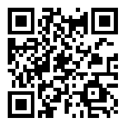
Access as a Lens for Peer Tutoring
Flexibility, Universal Design & Multimodality
Annika Konrad, PhD
Institute for Writing and Rhetoric
Dartmouth College
Slides and handouts available at www.annikakonrad.com/presentations

Slide 2
Lisa
“And the kids loved it because it was so empowering for them to not have to be controlled by a hand raise.”

Slide 3
Lisa Employers
“And the kids loved it because it was so empowering for them to not have to be controlled by a hand raise.”
“You don’t have control of the classroom because they’re not raising their hands.”

Slide 4
Lisa Employers
“And the kids loved it because it was so empowering for them to not have to be controlled by a hand raise.”
“You don’t have control of the classroom because they’re not raising their hands.”
“That’s brilliant because it’s teaching them how to have conversation rather than dictating!”

Slide 5
Normative Commonplaces
the ideological resources available in workplaces for making arguments that define where, when, how, and by whom work is performed and how work is measured.

Slide 6
Normative Commonplaces
Where do they live in writing centers?
How can we reimagine them?

Slide 7
19%
of undergraduate students in the U.S. have a disability

Slide 8
Agenda
What is Access?
Universal Design
Application to Writing Center Practice
Planning Future Action and Take-aways

Slide 9
What Access Looks Like
For me…
Volunteer to moderate
Help with media
Ways you can participate…
State your name
Eye contact
iPad is a point of access
Ask questions
For you…
www.annikakonrad.com > “Presentations”
Visual information will be read aloud or described
Clear and simple language
Use this space as you need
Communicate with me

Slide 10
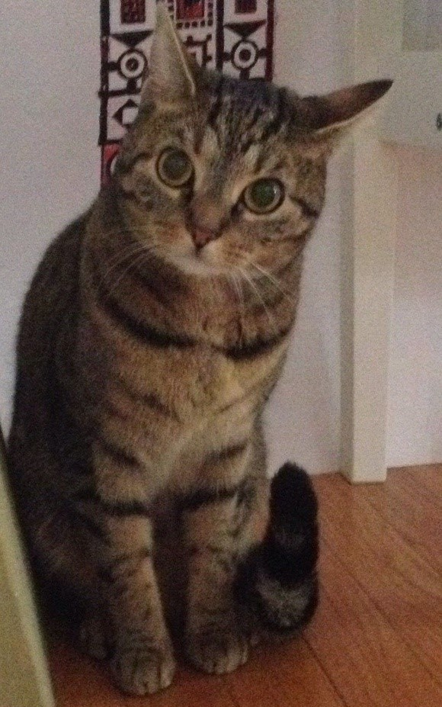
What Access Looks Like
For you…
www.annikakonrad.com “Presentations”
Visual information will be read aloud or described
Clear and simple language
Use this space as you need
Communicate with me

Slide 11
Agenda
What is Access?
Universal Design
Application to Writing Center Practice
Planning Future Action and Take-aways

Slide 12
Access is…
“the ability to use, enjoy, perform, work on, avail of, and participate in a resource, technology, activity, opportunity, or product at an equal or comparable level with others. Separate is not equal and before or after the fact is also not equal”
Sushil Oswal, “Multimodality in Motion,” 2014

Slide 13
Access is…
“the ability to use, enjoy, perform, work on, avail of, and participate in a resource, technology, activity, opportunity, or product at an equal or comparable level with others. Separate is not equal and before or after the fact is also not equal”
Sushil Oswal, “Multimodality in Motion,” 2014
Think of a time when you (or someone you know) did not have access to something. How did this make you feel? What did you do? Who or what helped you reach your goal?

Slide 14
Reflection in Pairs
How do these experiences make us feel?
What could have been done to help?
How would it have felt if the barriers had been removed?

Slide 16
Agenda
What is Access?
Universal Design
Application to Writing Center Practice
Planning Future Action and Take-aways

Slide 17
Universal Design
“Universal Design is the design of products and environments to be usable by everyone, to the greatest extent possible, without the need for adaptation or specialized design.”
Ron Mace (1941-1998), Creator of the concept and the term “Universal Design,” and Fellow of the American Institute of Architects

Slide 18
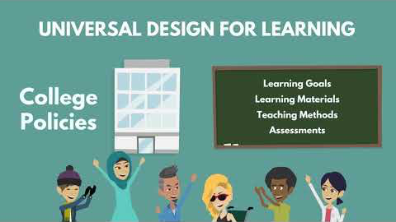
Universal Design for Learning
https://www.youtube.com/watch?v=AGQ_7K35ysA

Slide 19
Agenda
What is Access?
Universal Design
Application to Writing Center Practice
Planning Future Action and Take-aways

Slide 20
Example Scenario
Kelly, a peer tutor, is meeting with Michael, a first-year student for the first time. Kelly is finding it difficult to engage Michael in conversation. Michael looks out the window during the entire conference and does not make eye contact once. He does not provide any questions or comments on his own work and only responds to Kelly’s questions when she asks directly. Even when using direct questions, she has a difficult time getting him to say more than two sentences in an entire conference. He does not appear upset or confrontational, and he has not provided any explanation for his silence. How might Kelly engage Michael?

Slide 21
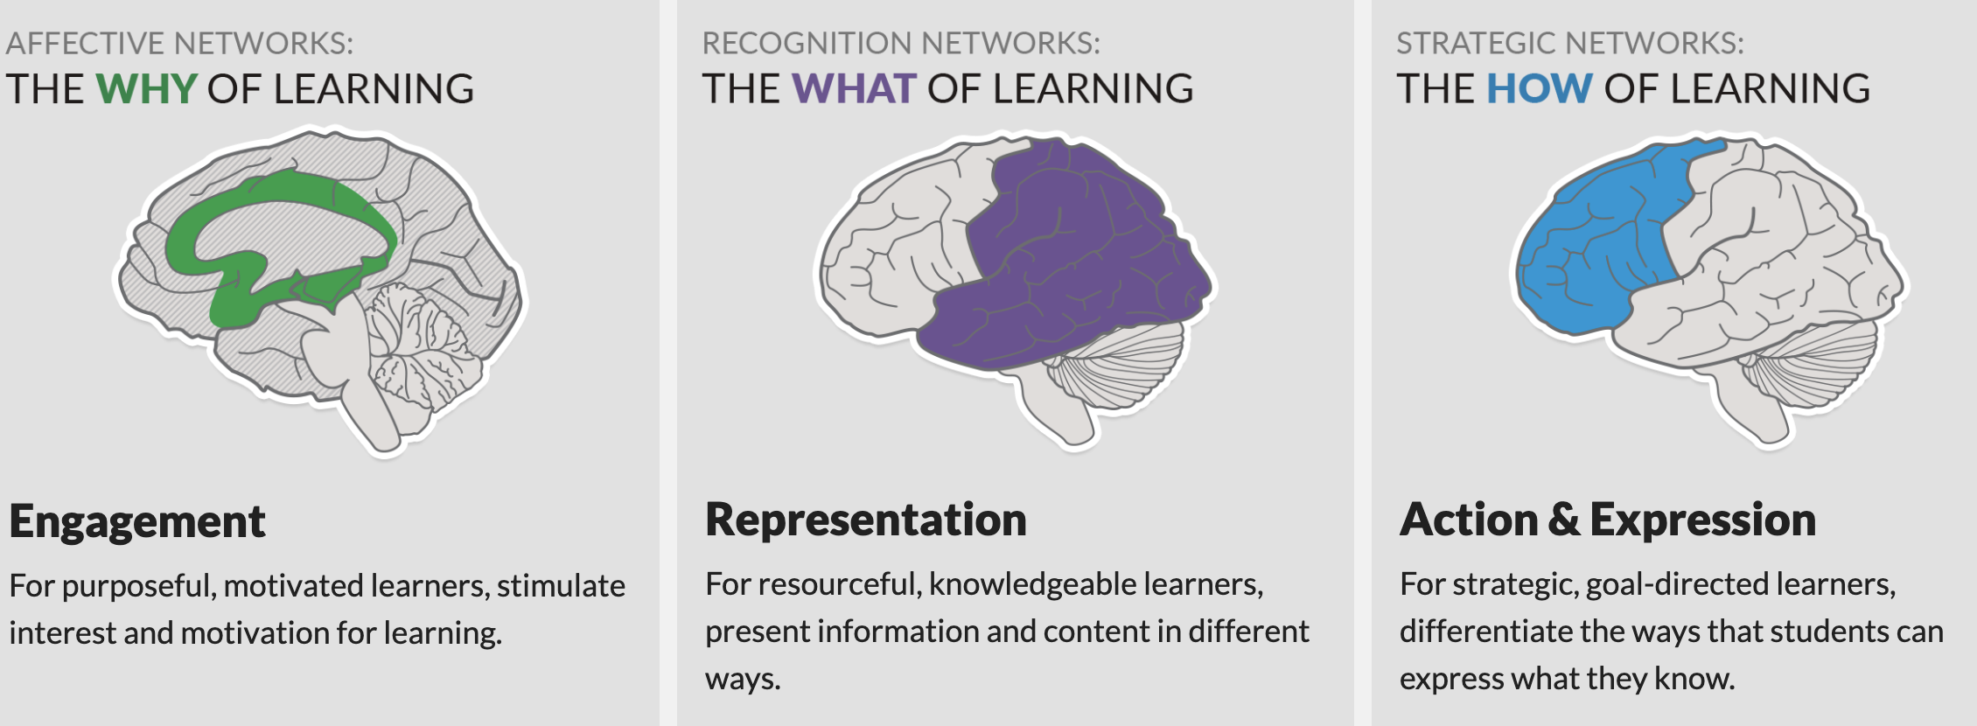
Example Scenario
Normative Commonplace: “what student engagement looks like”
UDL strategies: writing, chatting, listening, moving

Slide 22
Applying UDL to Peer Tutoring
Pick 1-2 scenarios
You have 2 goals
1. Identify at least one commonplace that gets in the way
2. Identify at least one new or more flexible way of tutoring
Use principles of UDL to brainstorm strategies (see handout)

Slide 23
Scenario 1
Nelson is a regular in the Writing Center. He is a senior working on a long writing project for an “incomplete” he received for a course he took the previous semester. He needs to finish the writing project this semester in order to graduate on time. Hannah, a peer tutor, has been trying to help Nelson plan his long project by breaking it up into smaller steps and scheduling writing tasks for Nelson. Every time Hannah sets goals for Nelson to complete by their next meeting, however, Nelson does not meet the goals. He tells Hannah that he has trouble getting words on a page and that he spends hours staring at a blank screen. Nelson has not disclosed a disability or relationship with the disability resource center. What can Hannah do to help Nelson complete his project?

Slide 24
Scenario 2
In a writing center conference, a student writer, Leo, discloses a mental disability that requires that they type in order to communicate and process language. The peer tutor, Arthur, is ready to be flexible but he realizes that the student’s need to type conflicts with his own reliance on and preference for auditory processing and reading the student writer’s tone and body language. Arthur is concerned about his own ability to read emotion and tone while Leo types. How should Arthur go about constructing a situation that is accessible for both of the tutor and the student writer?

Slide 25
Scenario 3
Valerie, a peer tutor, is about to meet with a student writer, Eric, for the second time. Eric seemed to really enjoy their first conference, but Valerie is worried about her second conference with Eric because he talked so much that their conversation went way over time and he often strayed from the topic at hand. Valerie also noticed that Eric seemed quite distracted and left the table a couple of times, making their conference really long. Valerie appreciates Eric’s enthusiasm, but she worries about how to keep the conversation focused and make sure they don’t go over time. How should Valerie approach her second conference with Eric?

Slide 26
Scenario 4
Maria, who is blind, uses screen reading software to read (software that reads computer text aloud to the user) and text-to-speech software to write. Because text-to-speech software is not always accurate, Maria’s writing is full of incorrect words, missing formatting, and incorrect or missing punctuation. Since Maria can’t see the text, however, her peer tutor, Ben, is unsure how to help Maria detect these errors on her own and he worries that pointing all of them out would make her self-conscious about her writing. How should Ben approach this situation?

Slide 27
Scenario 5
Anna is a peer tutor who has ADHD. While she loves her work in the writing center, she finds it difficult to concentrate while student writers are reading their papers aloud, especially when the papers are longer than a few pages. Anna finds that when the writer is done reading, she hasn’t comprehended most of the paper. Anna is not comfortable disclosing her disability to the writers she meets with. What can she do to make the work of peer tutoring more accessible for herself?

Slide 28
Scenario 6
Jasmine is meeting with a student writer, Nolan, for the first time and immediately when Nolan starts speaking, Jasmine recognizes that she has a hard time understanding his speech. Jasmine notices that Nolan doesn’t show any signs that he is aware Jasmine might have trouble understanding his speech—he appears comfortable and continues talking to Jasmine about his writing and at times Nolan gets up and starts walking around as he’s telling Jasmine about his paper. Once they reach the point of reading Nolan’s draft, Jasmine is not sure whether to ask Nolan to read his paper aloud and what she should do about struggling to understand his speech.

Slide 29
Agenda
What is Access?
Universal Design
Application to Writing Center Practice
Planning Future Action and Take-aways

Slide 30
Critiques of Universal Design
Why do we need to make something useful for all in order for it to be accessible to people with disabilities?
It can elide or erase disability.
Who is getting excluded while we expand access for “all”?
There is no access utopia.

Slide 31
General strategies to keep in mind
Peer tutoring is not a fixed model
Be flexible with time, space, and tools
Offer multiple different options
Develop a relationship with your office of disability services
Examine the physical and digital spaces
Consider your hiring practices
Pay attention to your own access needs
You don’t have to do it perfectly

Slide 32
Reflections on Applications of UDL
What practices have you already used in your writing center that help create access?
What strategies, tools, concepts, practices, habits could you introduce to your writing center that would help create access?
Who on your campus would be a good resource for developing a more accessible writing center and what questions might you ask them?

Slide 33
Call to Action
Pre-emptive
Proactive
Creative
Anticipatory
Interdependent
Culture of Access
“Everyone participates in making what is noticed and imagined as disability” (Tanya Titchkosky, 2011).

Slide 34
Thank you!
Feel free to contact me with thoughts, questions, ideas at
annika.m.konrad@dartmouth.edu
annikakonrad@gmail.com
Learn more about my work at
annikakonrad.com

Slide 35
Where to look to learn more
Allison Hitt, “Access for All: The Role of Disability in Multiliteracy Centers.” Praxis: Aiting Center Journal 9.2
Alexandra (Sasha) Yambor, “Writing Center Tutors and Students with Learning Disabilities: Perceptions, Feelings, and Tutoring Strategies” Queen City Writers, 4.2
Elizabeth Kleinfeld, “Taking an Expansive View of Accessibility: The Writing Center at Metropolitan State University of Denver” Composition Forum 39, 2018
Rebecca Day Babcock and Sharifa Daniels, Writing Centers and Disability, Fountainhead Press, 2017

